Slide 1
Introduction to Data Visualization
The greatest value of a picture is when it forces us to notice what we never expected to see. —John W. Tukey, Exploratory Data Analysis
Qualities of visualization
Visualization wheel

Slide 2
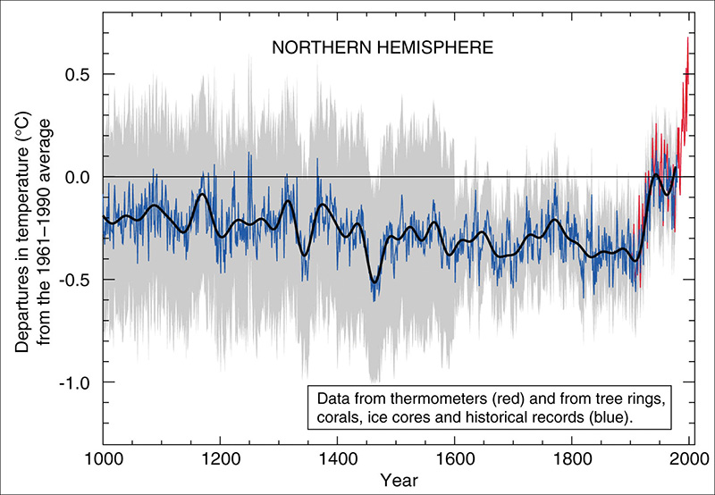
Five Qualities of Great Visualizations
The Hockey Stick Chart: in the first years of the twentieth century, temperatures experienced a sharp rise
It’s a success story, because it has certain qualities:
Truthful
Functional
Beautiful
Insightful
Enlightening

Slide 3
Hockey Stick Chart Qualities
Truthful, as it’s based on thorough and honest research.
Functional, as it constitutes an accurate depiction of the data, and it’s built in a way that lets people do meaningful operations based on it (seeing change in time).
Beautiful, in the sense of being attractive, intriguing, and even aesthetically pleasing for its intended audience – scientists, general public.
Insightful, as it reveals evidence that we would have a hard time seeing otherwise.
Enlightening because if we grasp and accept the evidence it depicts, it will change our minds for the better.

Slide 4
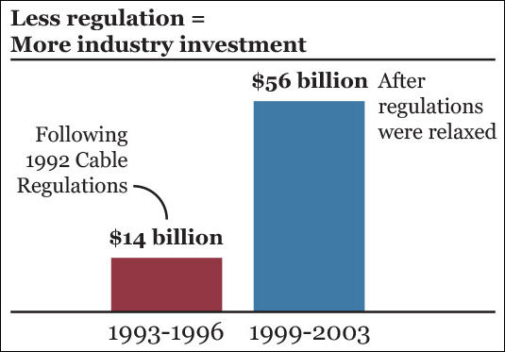
Qualities of a Great Visualization
Truthful
Be aware of your actions when cleaning, summarizing and manipulating data and ensure you aren’t
Misleading yourself (self deception) and your audience
Can you tell what is fishy in 10 seconds?
Notes:
First, it's unclear whether the monies are adjusted for inflation, which is a big issue when providing charts of financial data.
Second, the time spans for the two bars are different. One covers a span of three years, while the other covers a span of four years.
Think of this through the lens of Tufts' Lie Factor Analysis. The bars have the same width, but don't represent the same period of time.

Slide 5
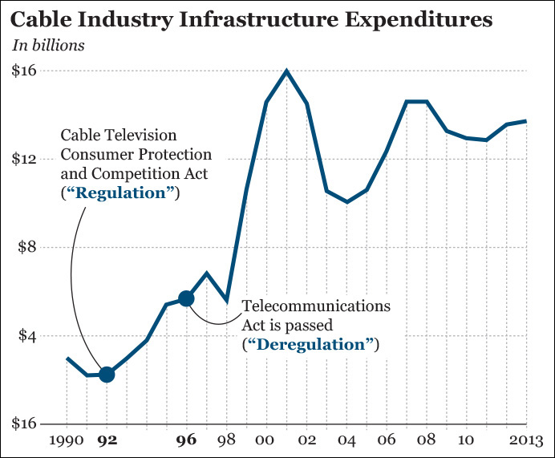
Qualities of a Great Visualization
You may not be lying, but you may not be telling the whole truth.
Line graph with 1998 gives the complete picture.

Slide 6
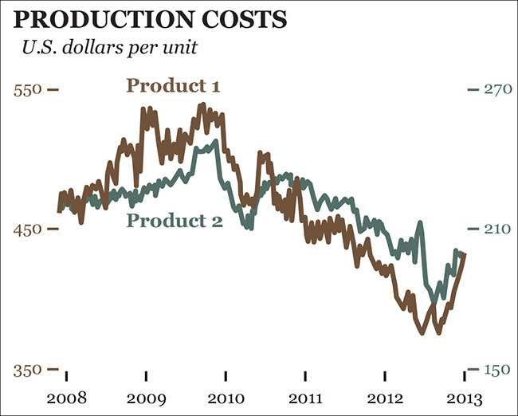
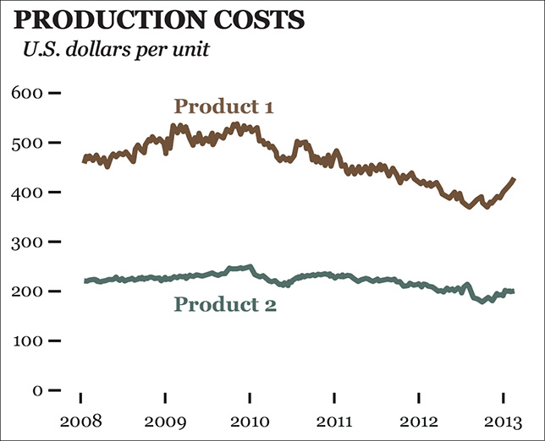
Qualities of a Great Visualization
“If you double the axes, you can double the mischief. Using two vertical axes and omitting zero from either or both opens a statistical beauty parlor with many cosmetic possibilities.”--Gary Smith
Notes:
Standard Deviations (2014)

Slide 7
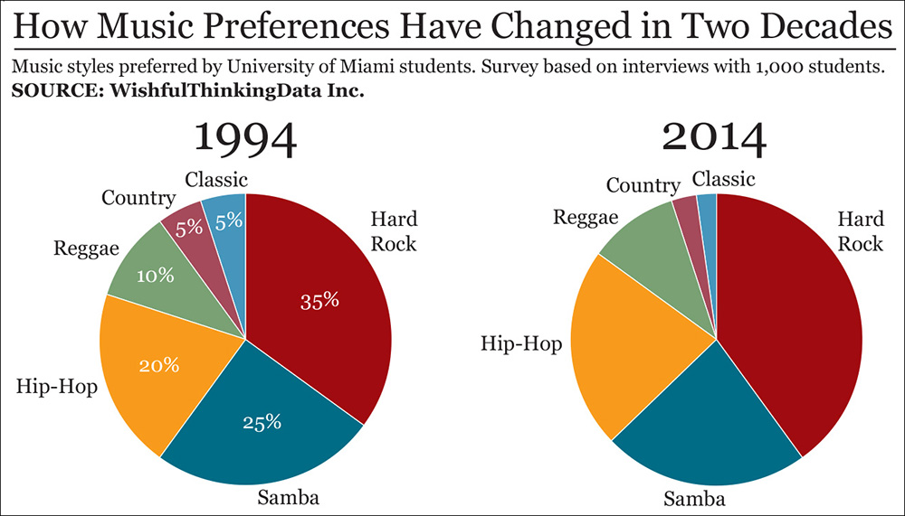
Qualities of a Great Visualization
Functionality
If getting your information right is the most important step in creating any visualization, the second one is helping the audience interpret it correctly.
Try to compare the popularity of hip-hop in 1994 and in 2014.
Were country and classic music equally popular in 2014, too?
Notes:
Edward Tufte: “The only worse design than a pie chart is several of them.”

Slide 8
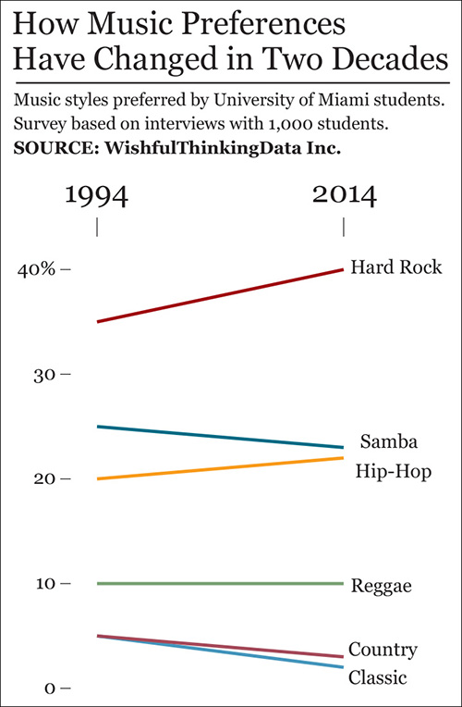
Qualities of a Great Visualization
A slope chart is much better
to represent change between
two points in time.
Notes:
The purpose of your graphics should somehow guide your decision of how to shape the information.

Slide 9
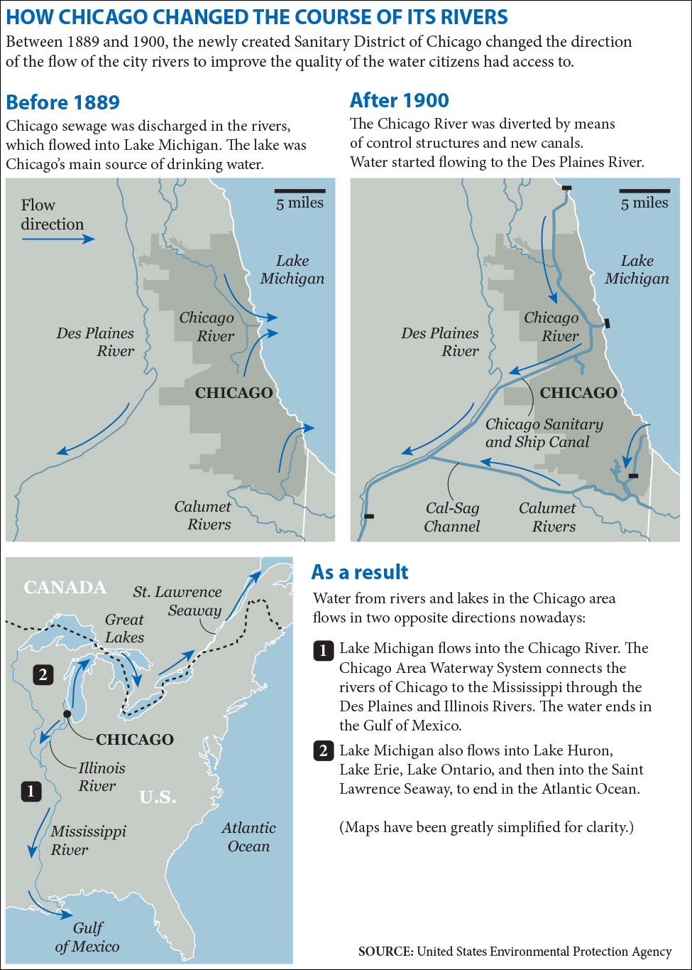
Qualities of a Great Visualization
Beauty
What matters isn’t if the objects of our creation are beautiful or not per se, but if they are experienced as beautiful by as many people as possible.
“Art moves us because it is beautiful, and it is beautiful because it means something. It can be meaningful without being beautiful; but to be beautiful it must be meaningful.” --Roger Scruton
Notes:
The very word “aesthetics” comes from the Greek (aisthetikos), which means sensation or feeling. As Donald A. Norman wrote in his book Emotional Design (2003), beauty matters because attractive and pleasing things work better.

Slide 10
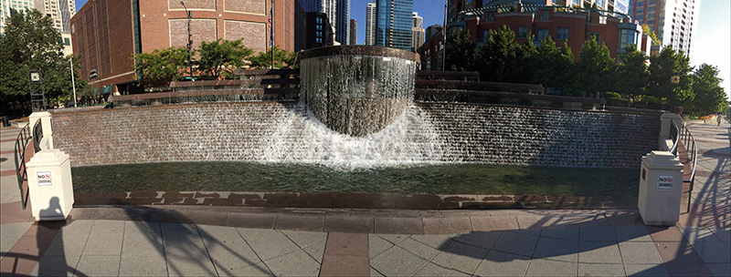
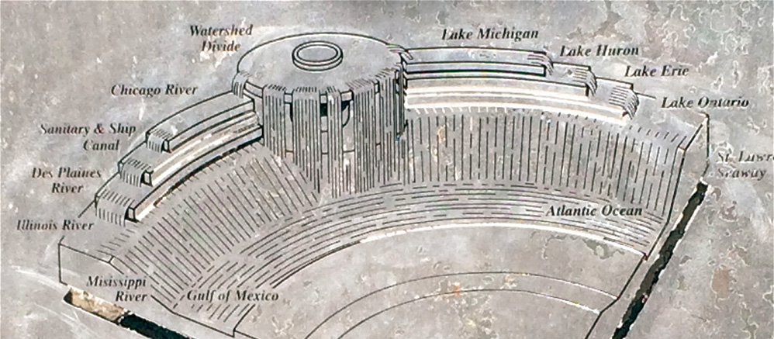
Qualities of a Great Visualization
Fountain itself is the visualization
The Centennial Fountain
An explanation of how to “read” the fountain, part of its signage

Slide 11
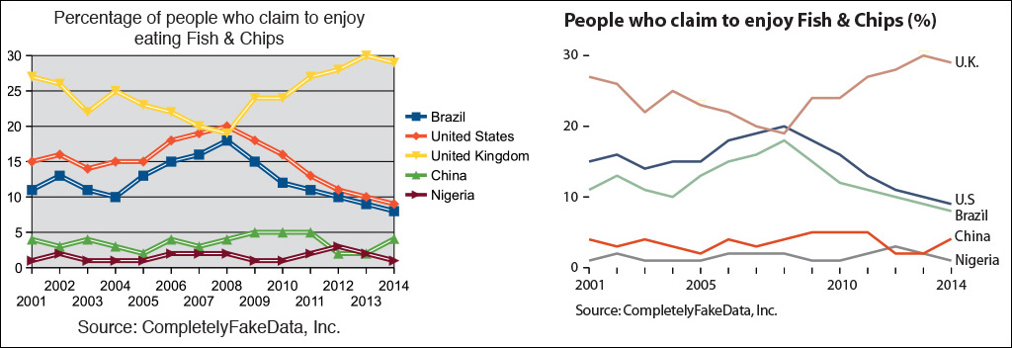
Qualities of a Great Visualization
Which chart is more aesthetically pleasing?

Slide 12
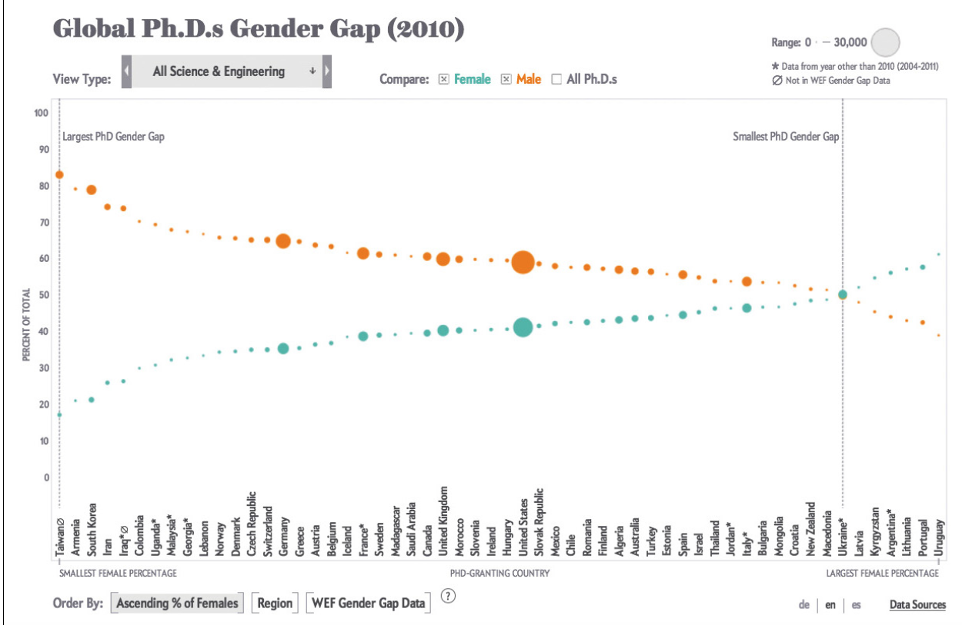
Qualities of a Great Visualization
Insightful
A “eureka” or “a-ha” moment
“The purpose of visualization is insight, not pictures”
Good visualizations are clear
the path to making valuable
discoveries that would be
inaccessible if the information
were presented in a different
https://www.scientificamerican.com/article/how-nations-fare-in-phds-by-sex-interactive1/
Notes:
The very word “aesthetics” comes from the Greek aísthImagesis, which means sensation or feeling. As Donald A. Norman wrote in his book Emotional Design (2003), beauty matters because attractive and pleasing things work better.

Slide 13

Qualities of a Great Visualization
Enlightening
A combination of the previous four, but with a social ethical responsibility
The goal of any candid visual communicator is to give people access to the information they need to increase their well-being.
Great visualizations change people’s minds for the better.
Some topics do matter more than others indeed because they are more critical to the well-being of more people.
vs. Child Mortality

Slide 14
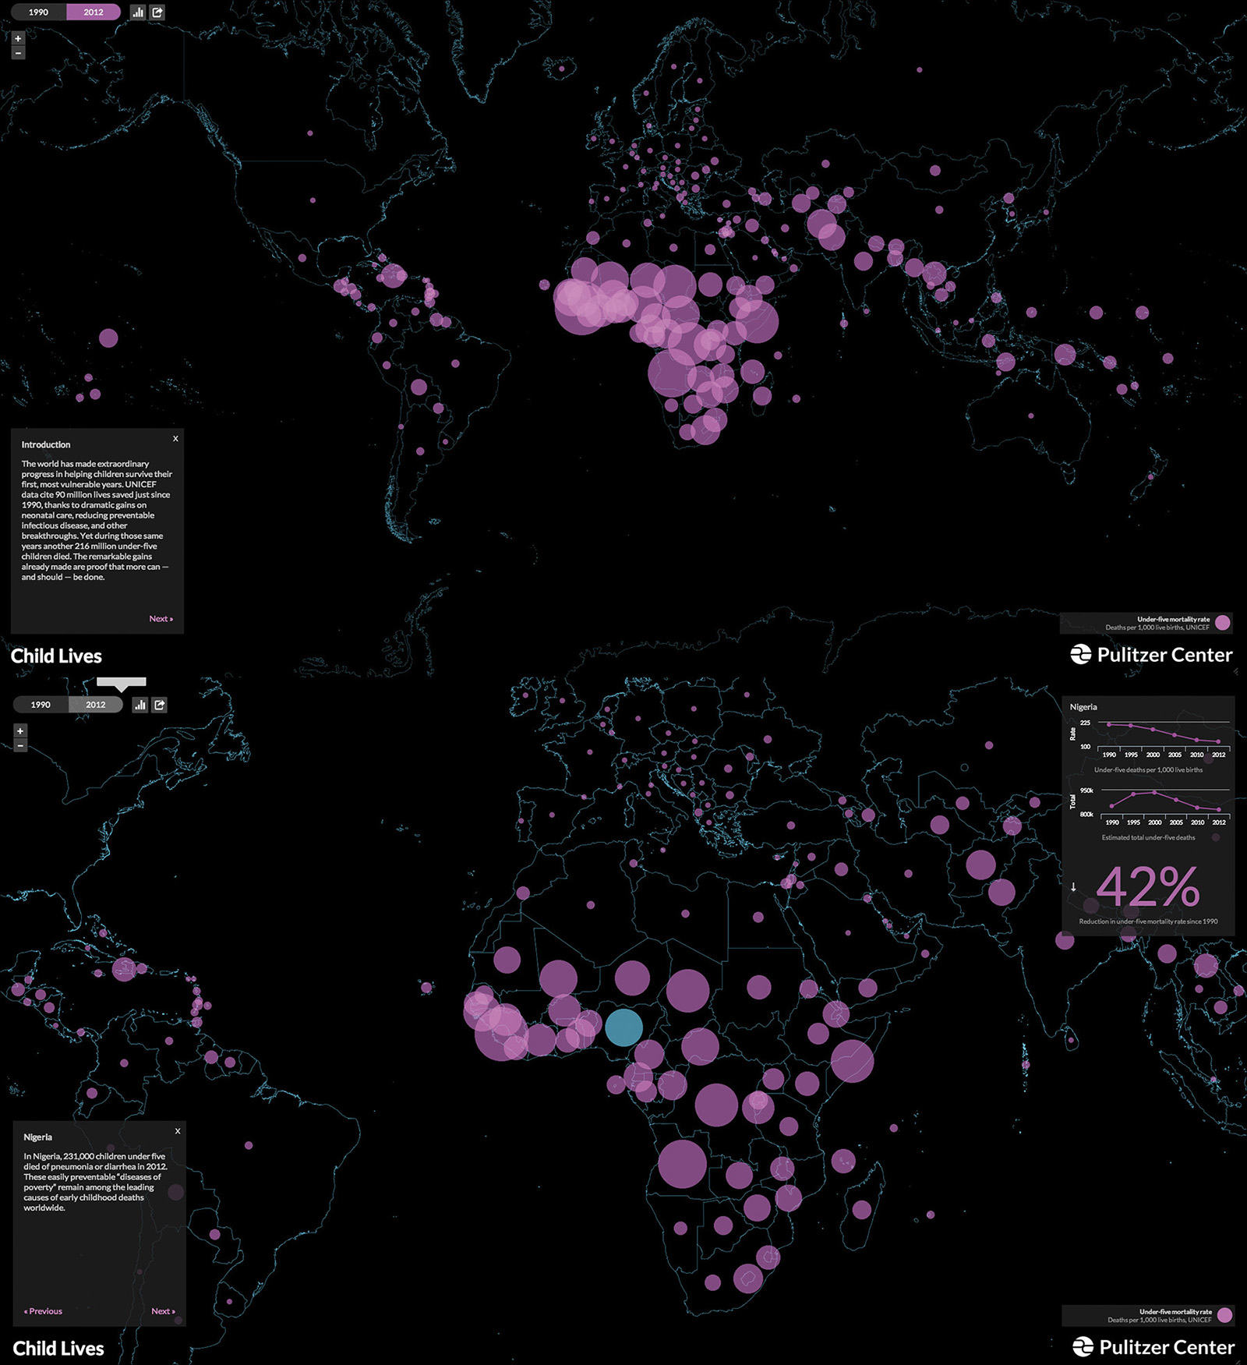
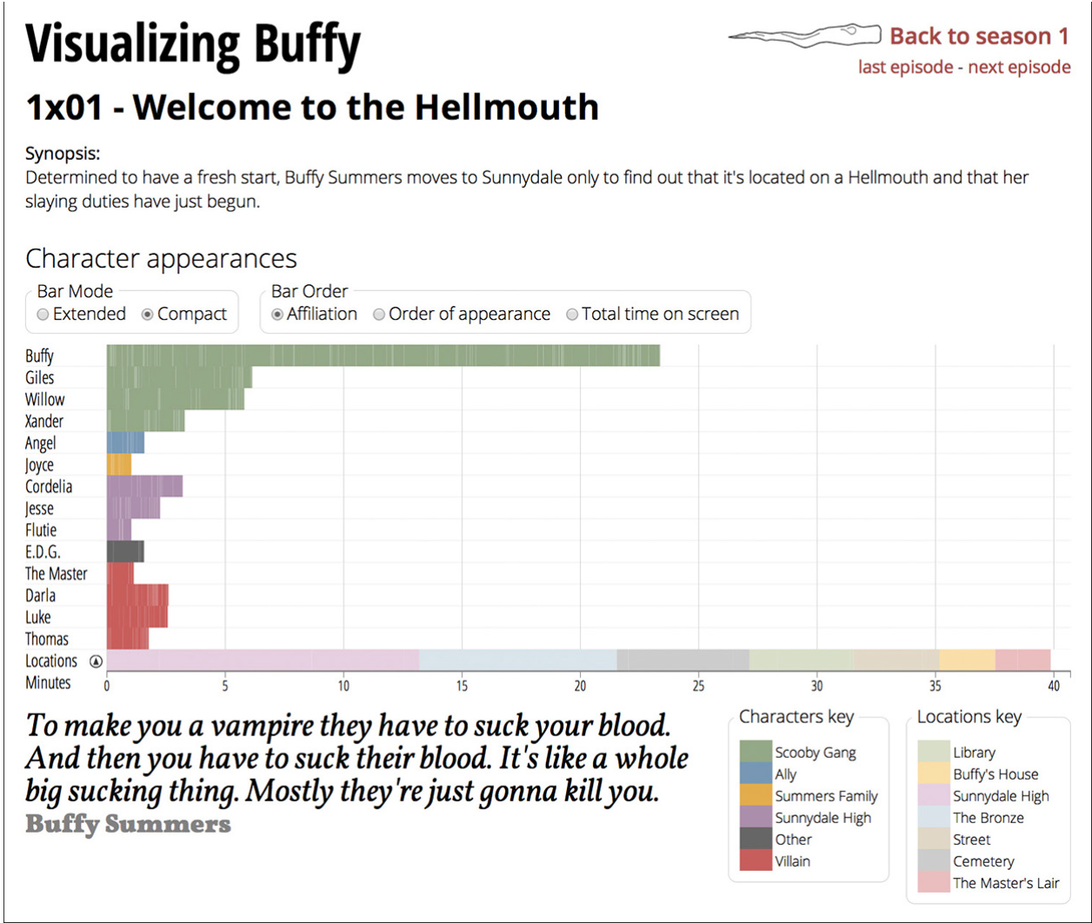
Qualities of a Great Visualization
Doughnuts or Broccoli?

Slide 15
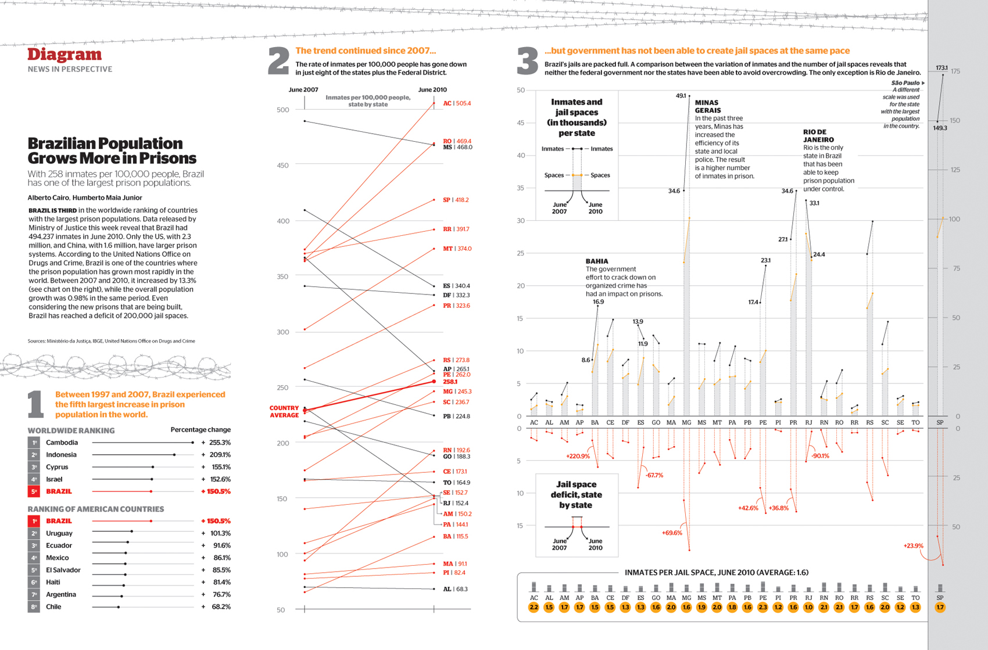
The Beauty Paradox: Art and Communication
1. Too complex
2. Too abstract
3. Too far from the aesthetics a majority of readers expect (“ugly”)
4. Too dense
But, won a Malofiej Infographics Award -- SOCIETY FOR NEWS DESIGN

Slide 16
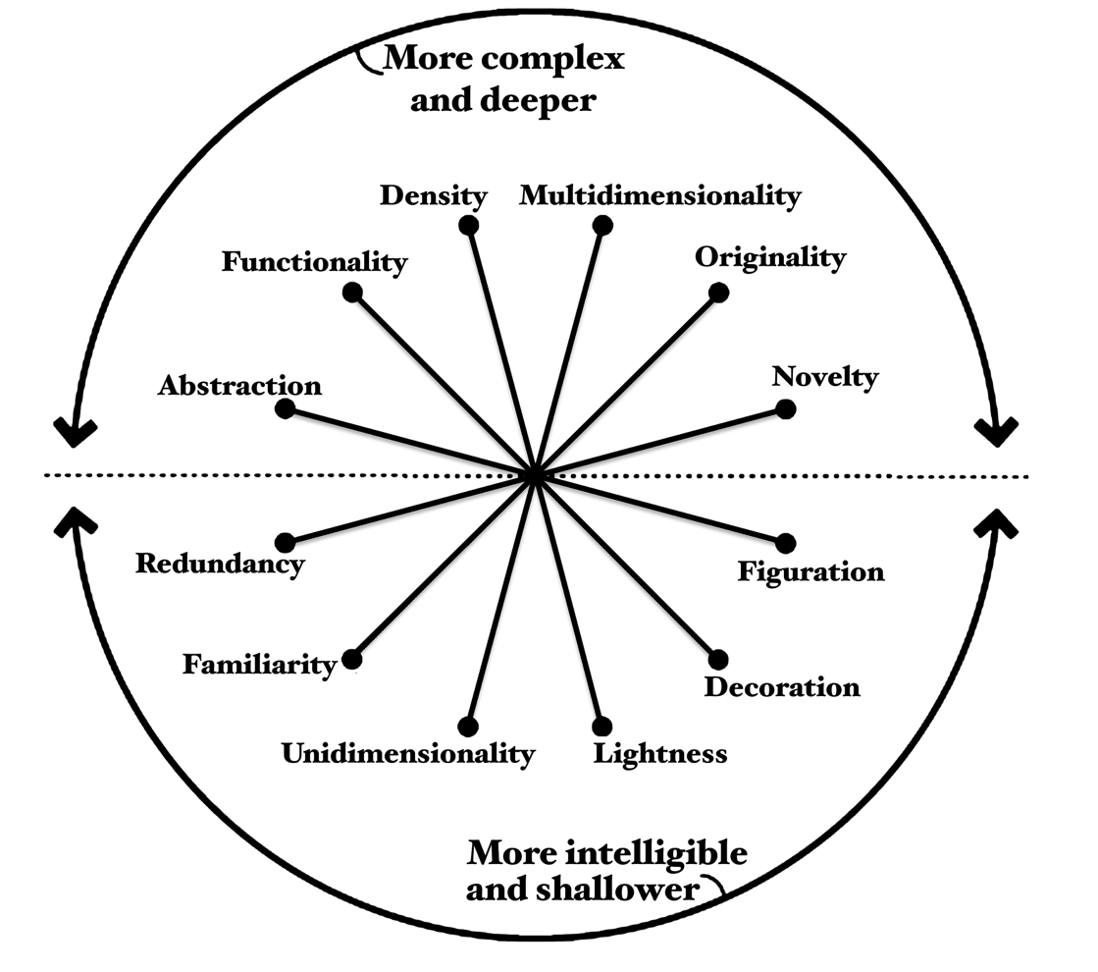
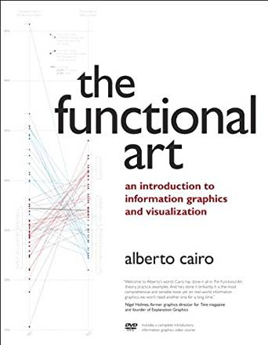
Visualization Wheel
Six pairs of characteristics that are opposite to one another with:
the first characteristic falling in the complex and deeper region
the second characteristic falling in the more intelligible and shallower region
Notes:
Image on the left: A visualization wheel that displays two regions: the top half of the wheel displays terms for complex and deeper visual characteristics and the bottom half of the wheel displays terms for more intelligible and shallower visual characteristics. There are six pairs of characteristics that are opposite to one another, with the first characteristic falling in the complex and deeper region and the second characteristic falling in the more intelligible and shallower region: Abstraction and Figuration, Functionality and Decoration, Density and Lightness, Multidimensionality and Unidimensionality, Originality and Familiarity, Novelty and Redundancy.
Image on the right: Alberto Cairo’s book cover image, The functional art : an Introduction to information graphics and visualization
[source] Cairo, A. (2013). The functional art: An introduction to information graphics and visualization. Berkley, CA: New Riders.

Slide 17
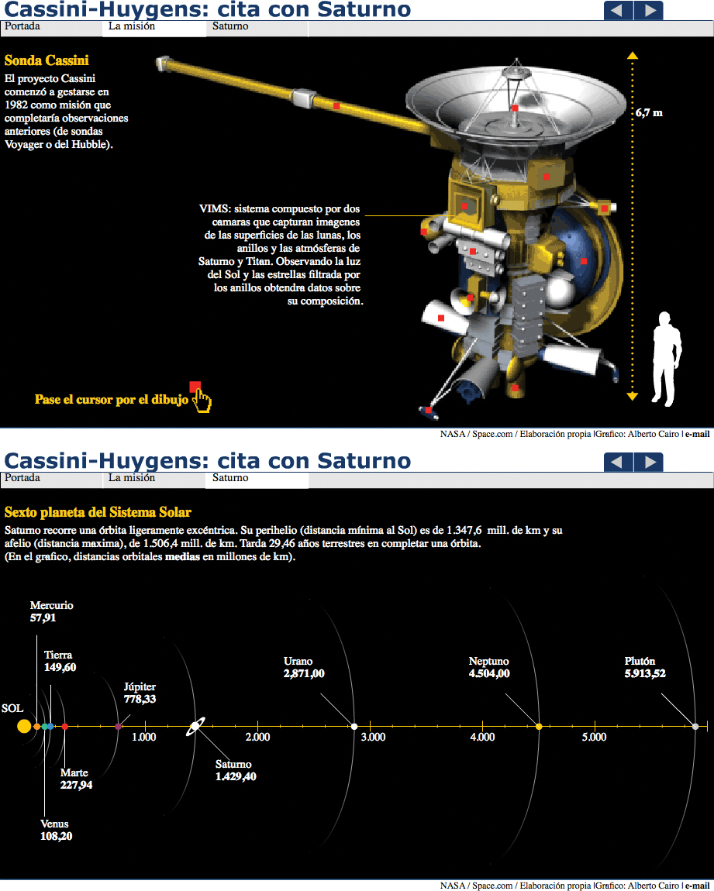
Visualization Wheel Dimensions
Abstraction ←→ Figuration
An information graphic is completely figurative when the relationship between the referent and its representation is perfectly mimetic.
Boxes and charts (abstraction) or real-world physical objects (figuration)
NASA Cassini-Huygens Mission to Saturn—which one is figurative?

Slide 18
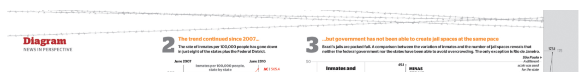
Visualization Wheel Dimensions
Functionality ←→ Decoration
No embellishments (functionality) or artistic embellishments (decoration)
Barbed wire is a non-functional visual element. It’s not a bad decoration per se, but it can interfere with the information in a chart if not handled well.

Slide 19
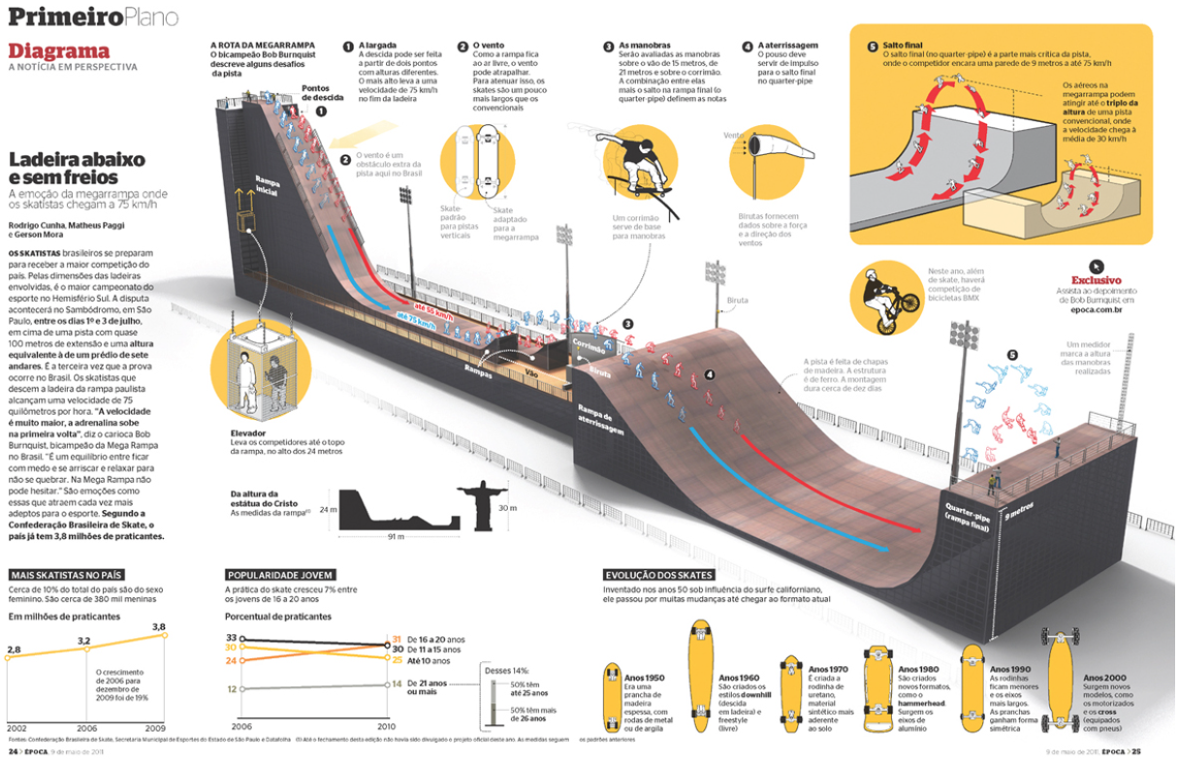
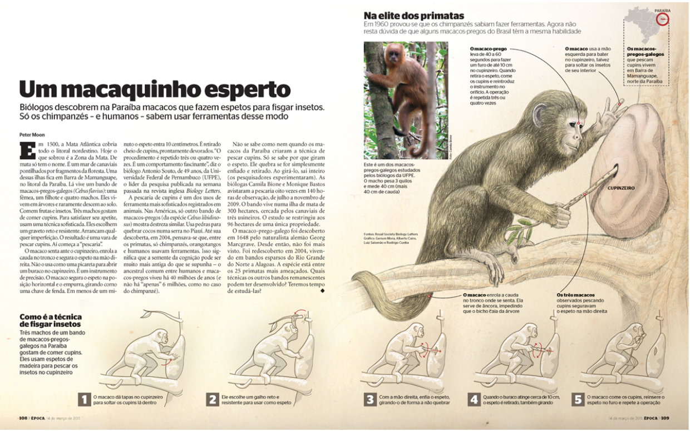
Visualization Wheel Dimensions
Density ←→ Lightness
Must be studied in depth (density) or understandable at a glance (lightness)
The amount of data it displays in relation to the space it uses.
Which one is light, which one is dense?

Slide 20
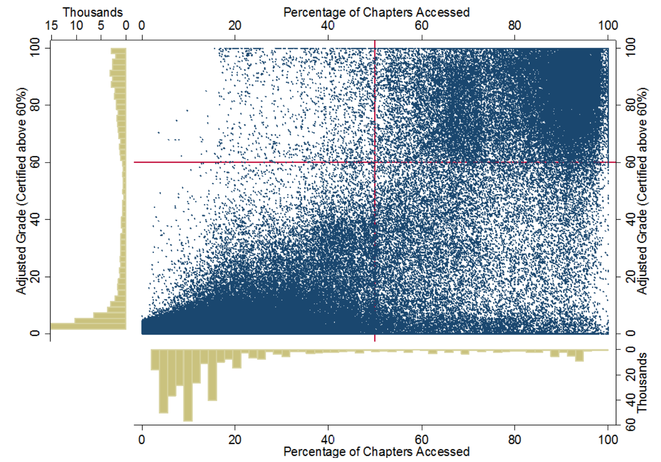
Visualization Wheel Dimensions
An example of dense graphic
Notes:
If we consider Cairo's third dimension. It'd be tough not to say that this is a fairly dense graphic. The main portion of the graphic, a scatterplot, has two axes which are labeled, as do each of the two subplots to the left and the bottom, which are histograms. The axis for the histograms can be a bit confusing as they bleed into the scatterplot axis, but change the unit of measure and the direction of the measurement. For instance, in the X axis at the top of the scatter plot, percentage of chapters access is being used as the unit of measure and increases as you move towards the right hand side of the figure. You have the same X axis for the histogram to the left of the graph is in thousands of persons and increases as you move to the left side of the figure. There's some red lines overlayed on the graphic. Breaking the scatter plot roughly into quadrants, but with minimal labeling it's a little unclear what the quadrants end up representing. Regardless of whether this is a good figure or not, it would certainly be considered an example of a dense figure.

Slide 21
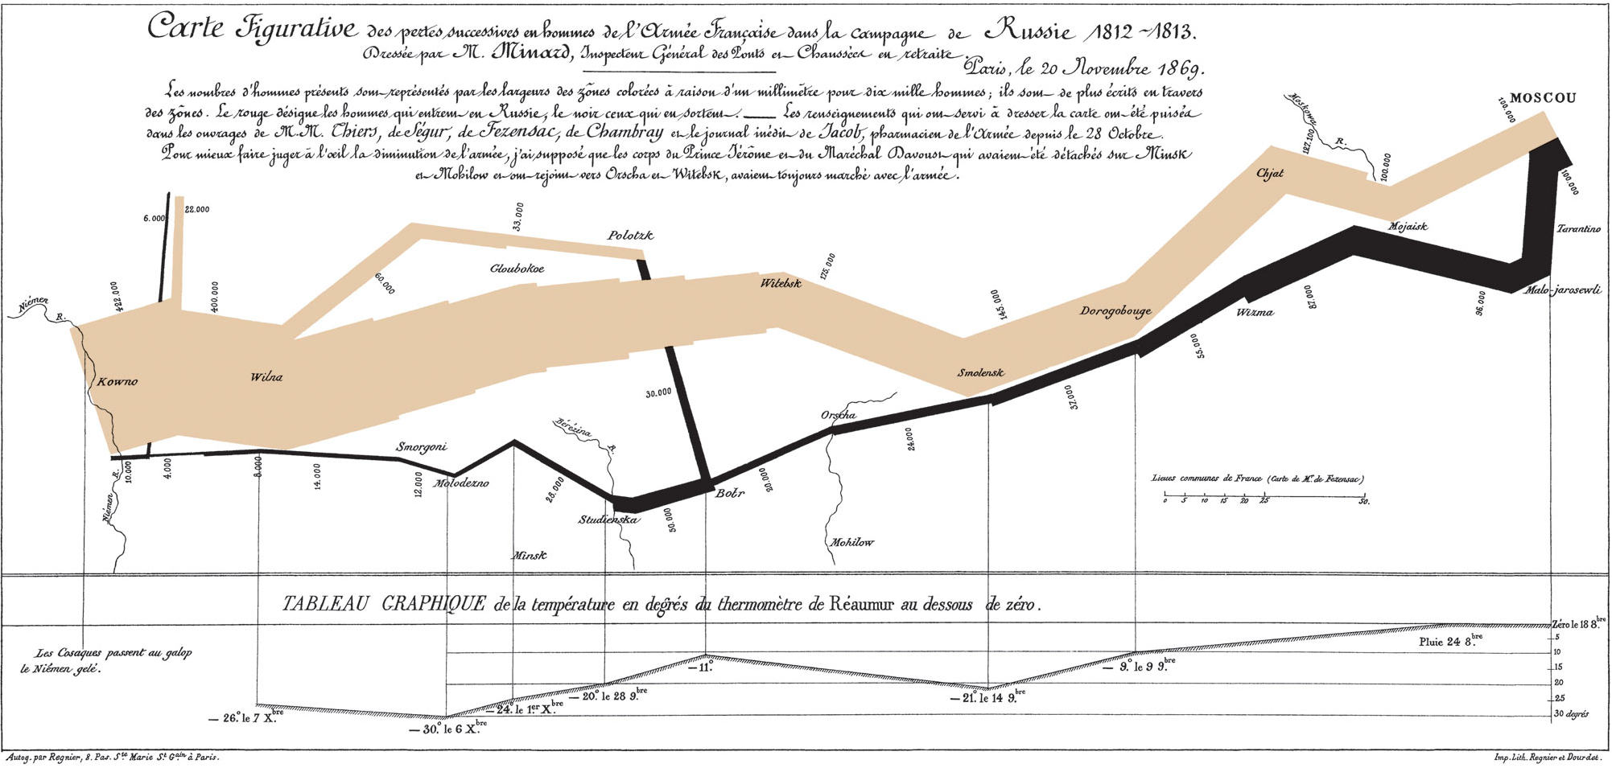
Visualization Wheel Dimensions
Multidimensional ←→ Unidimensional
A measure of two related variables: the number of layers of depth a graphic lets readers navigate, and the different forms it uses to encode the data.
Different aspects of phenomena (multidimensional) or single or few items of phenomenal (unidimensional)
Minard’s Napoleon's March & Cairo’s prison graphic are examples for multidimensional direction.
Notes:
First there are elements of geography showing us the various rivers in towns along the way.
The width of the tan upper bar represents the size of Napoleon's army, and you can see it shrinks from the beginning of the campaign from 422,000 to only 100,000 once the French reach Moscow.
The lower black bar shows Napoleon's retreat from Russia, and there are various points along it which are mapped to dates and temperatures in Celsius.
We see the bar thins dramatically as the army shrinks in size.
So the five kinds of data in Minard's visualization include location, direction, temperature, army size and dates.

Slide 22
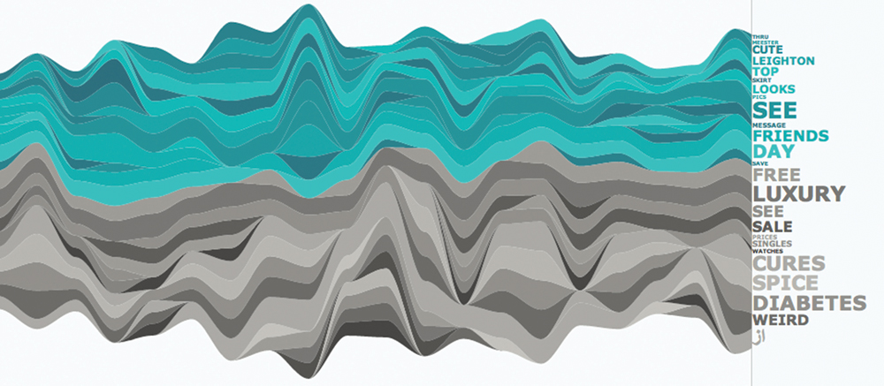
Visualization Wheel Dimensions
Originality ←→ Familiarity
Novel methods of visualization (originality) or established and well understood methods of visualization (familiarity)
Some graphic forms have become so common that they are almost as readable as text.
The explosion of the use of information graphics and visualization in many areas has fueled a desire to innovate new graphical forms such as theme rivers (stream graph))
An example of a stream graph. ©2011 Yahoo! Designed by Periscopic

Slide 23
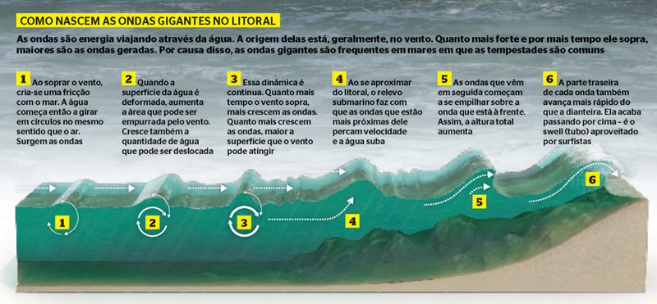
Visualization Wheel Dimensions
Novelty ←→ Redundancy
Explaining each item once (novelty) or encoding multiple explanations of the same phenomena (redundancy)
Striking a balance between novelty and redundancy is critical.
Novelty is important to avoid boring your readers, but a certain level of redundancy is necessary if you want to be understood.
Realistic illustrations accompanied by redundant copy.

Slide 24
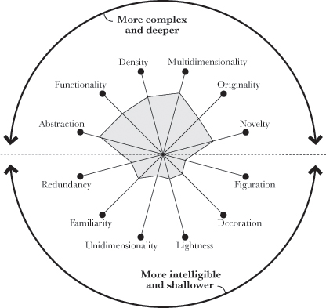
Visualization Wheel Dimensions
Brazilian prisons infographic using the visualization wheel
multidimensional
not very original
redundancy
more functional than beautiful
more abstract than figurative

Slide 25
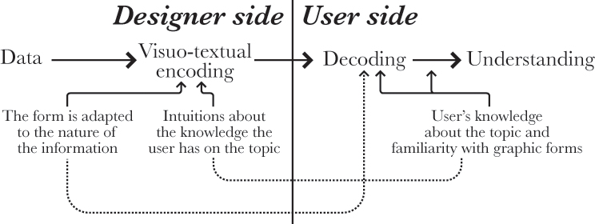
Identifying your audience
The complexity of a graphic should be adapted to the nature of your average reader. (Sounds easy!)
At least two factors influence the communication between a designer and an audience:
How well the visual forms used to encode the information are adapted to the nature of the story the graphic should tell.
The previous knowledge the user has about the topic & how those visual forms work.

Slide 26
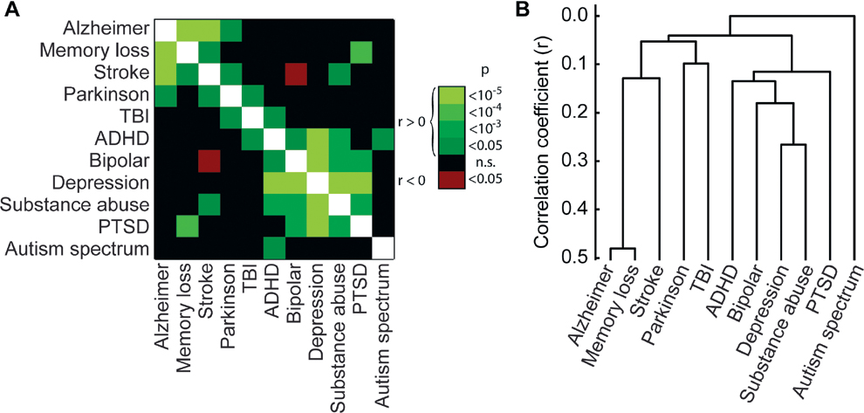
Identifying your audience
Try to figure out what these charts mean. It’s not easy, is it?
B.C. Campbell and S.S. Wang, “Familial Linkage between Neuropsychiatric Disorders and Intellectual Interests,” PLoS ONE 7(1): e30405. Accessed Feb. 23, 2012

Slide 27
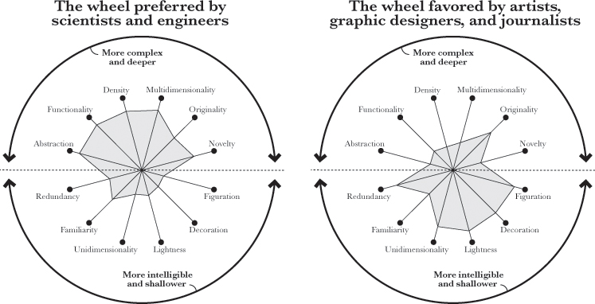
Engineers vs. Designers
Those who favor a rational, scientific approach vs. those who consider themselves “artists”
Notes:
emphasizing functionality vs, placing emphasis on emotion and aesthetics.

Slide 28
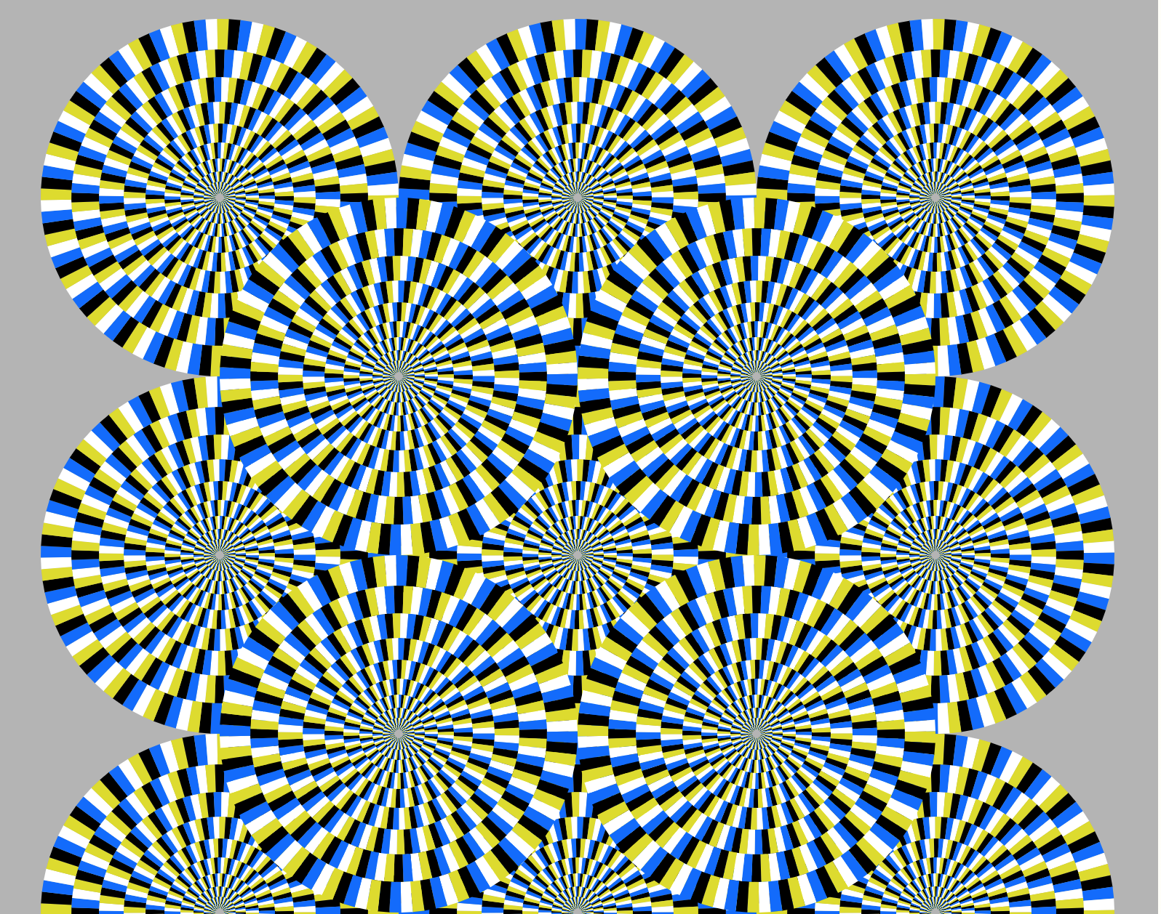
Have some fun with illusions
https://michaelbach.de/ot/

